Slide 1






A technical dive
IoT Mobile, data collecting, and A.I. integration

Slide 2



Introduction
We will talk about implementation solutions for BLE communication across Android, iOS, and Flutter platforms, along with common hardware targets like Nordic semiconductor boards, and integrated BLE chips.

Slide 3
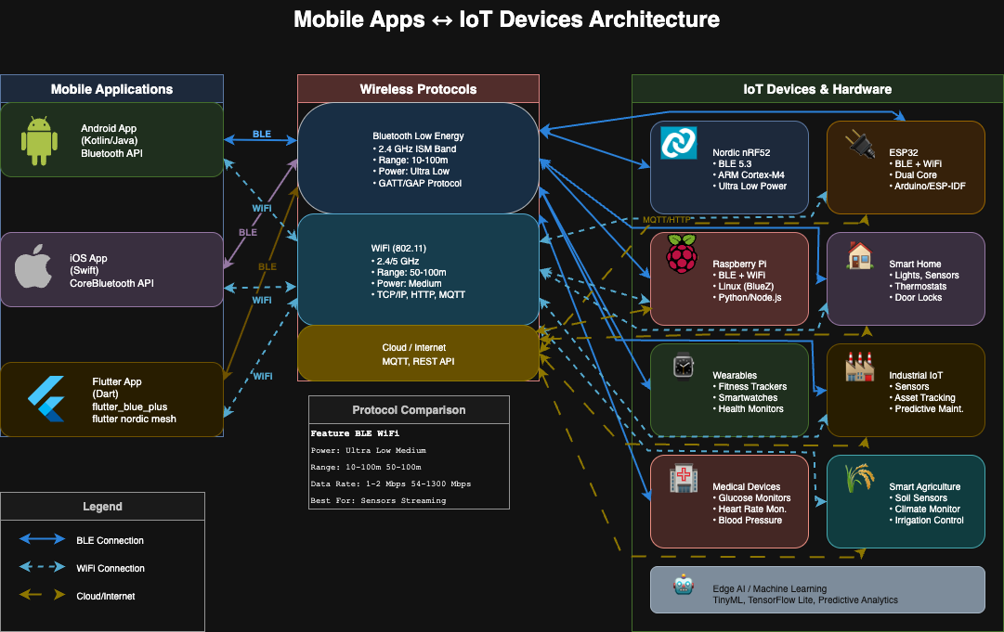

Title

Slide 4
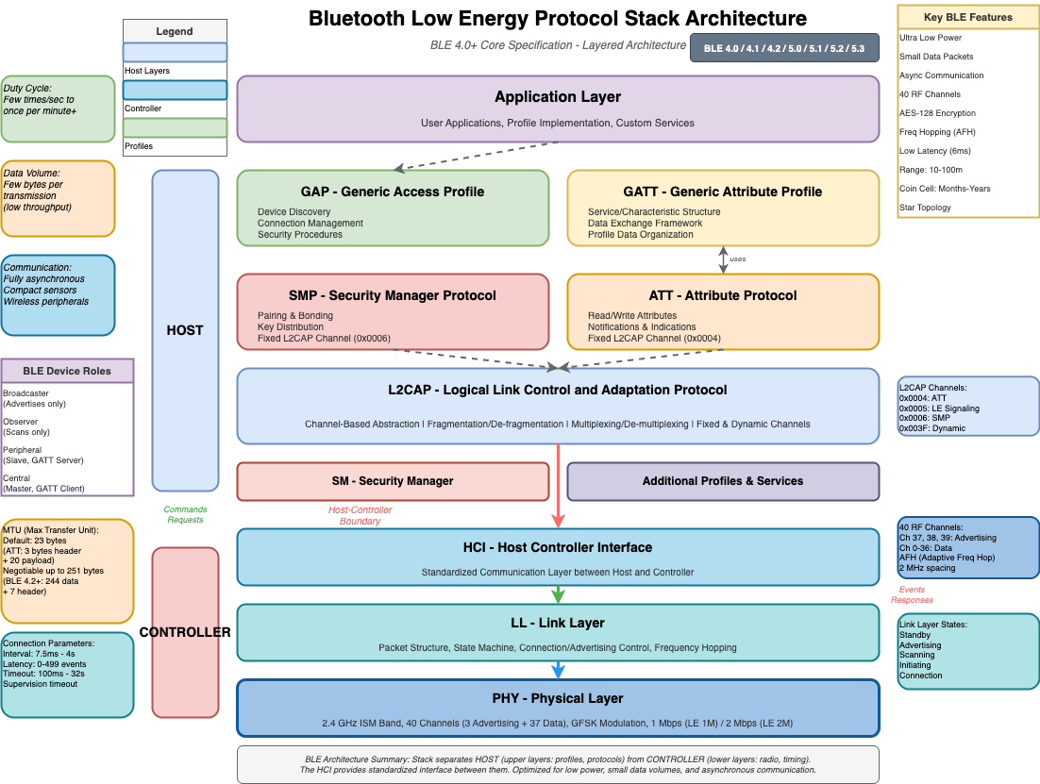

Slide 5
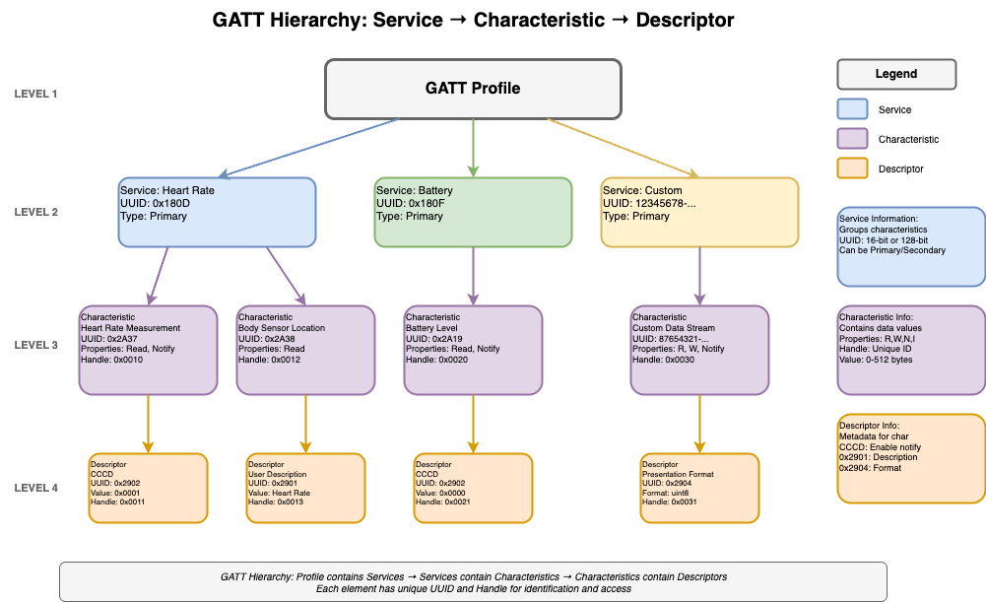
GATT Transfer

Slide 6
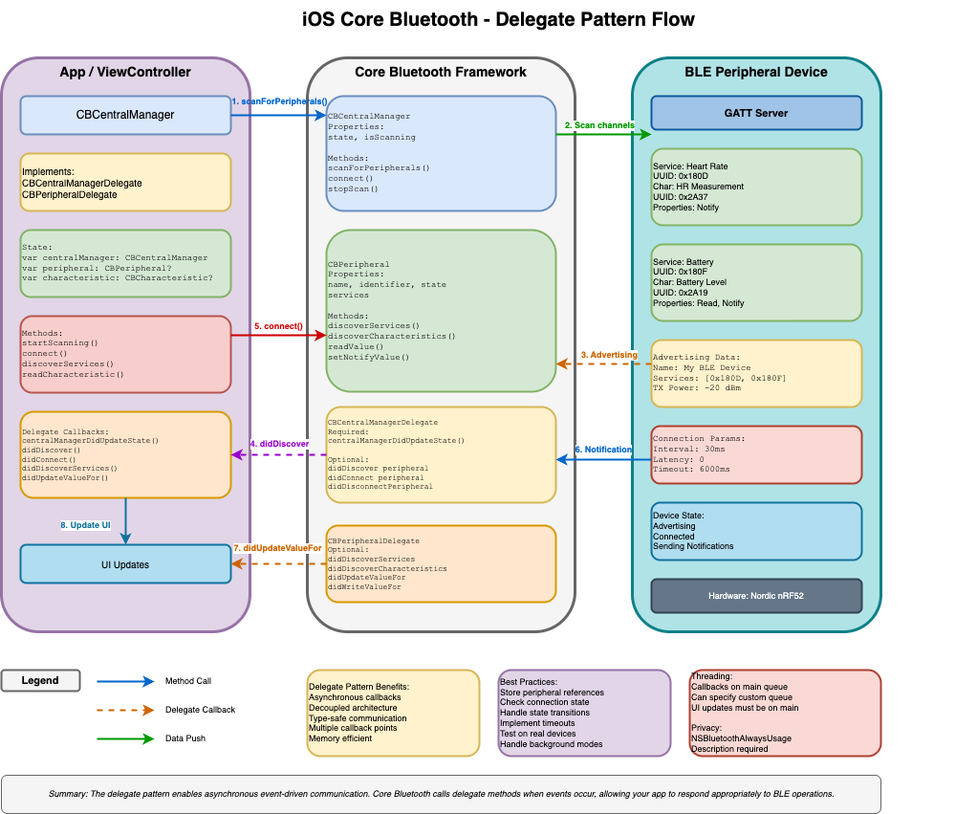
iOS Core Bluetooth Architecture

Slide 7
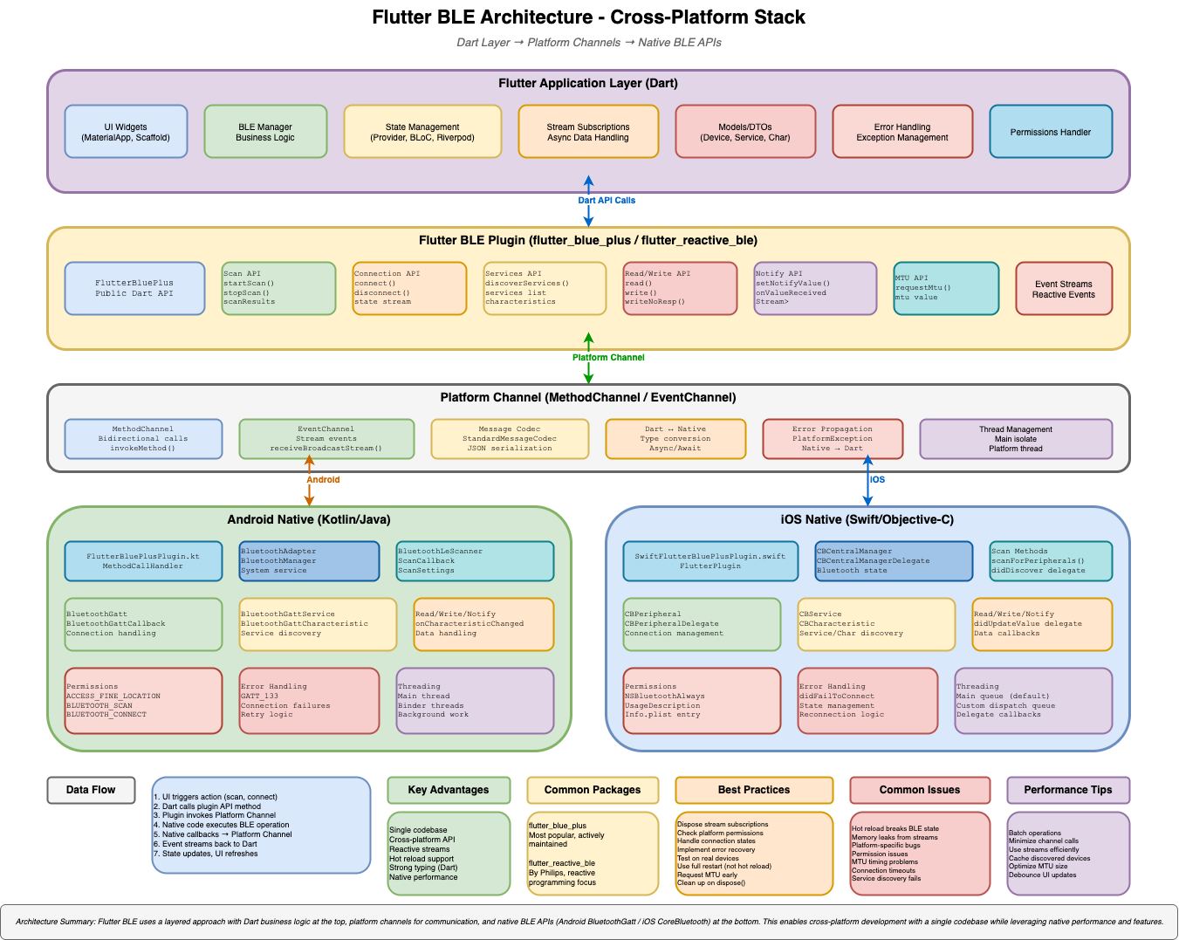
Flutter Bluetooth Architecture

Slide 8
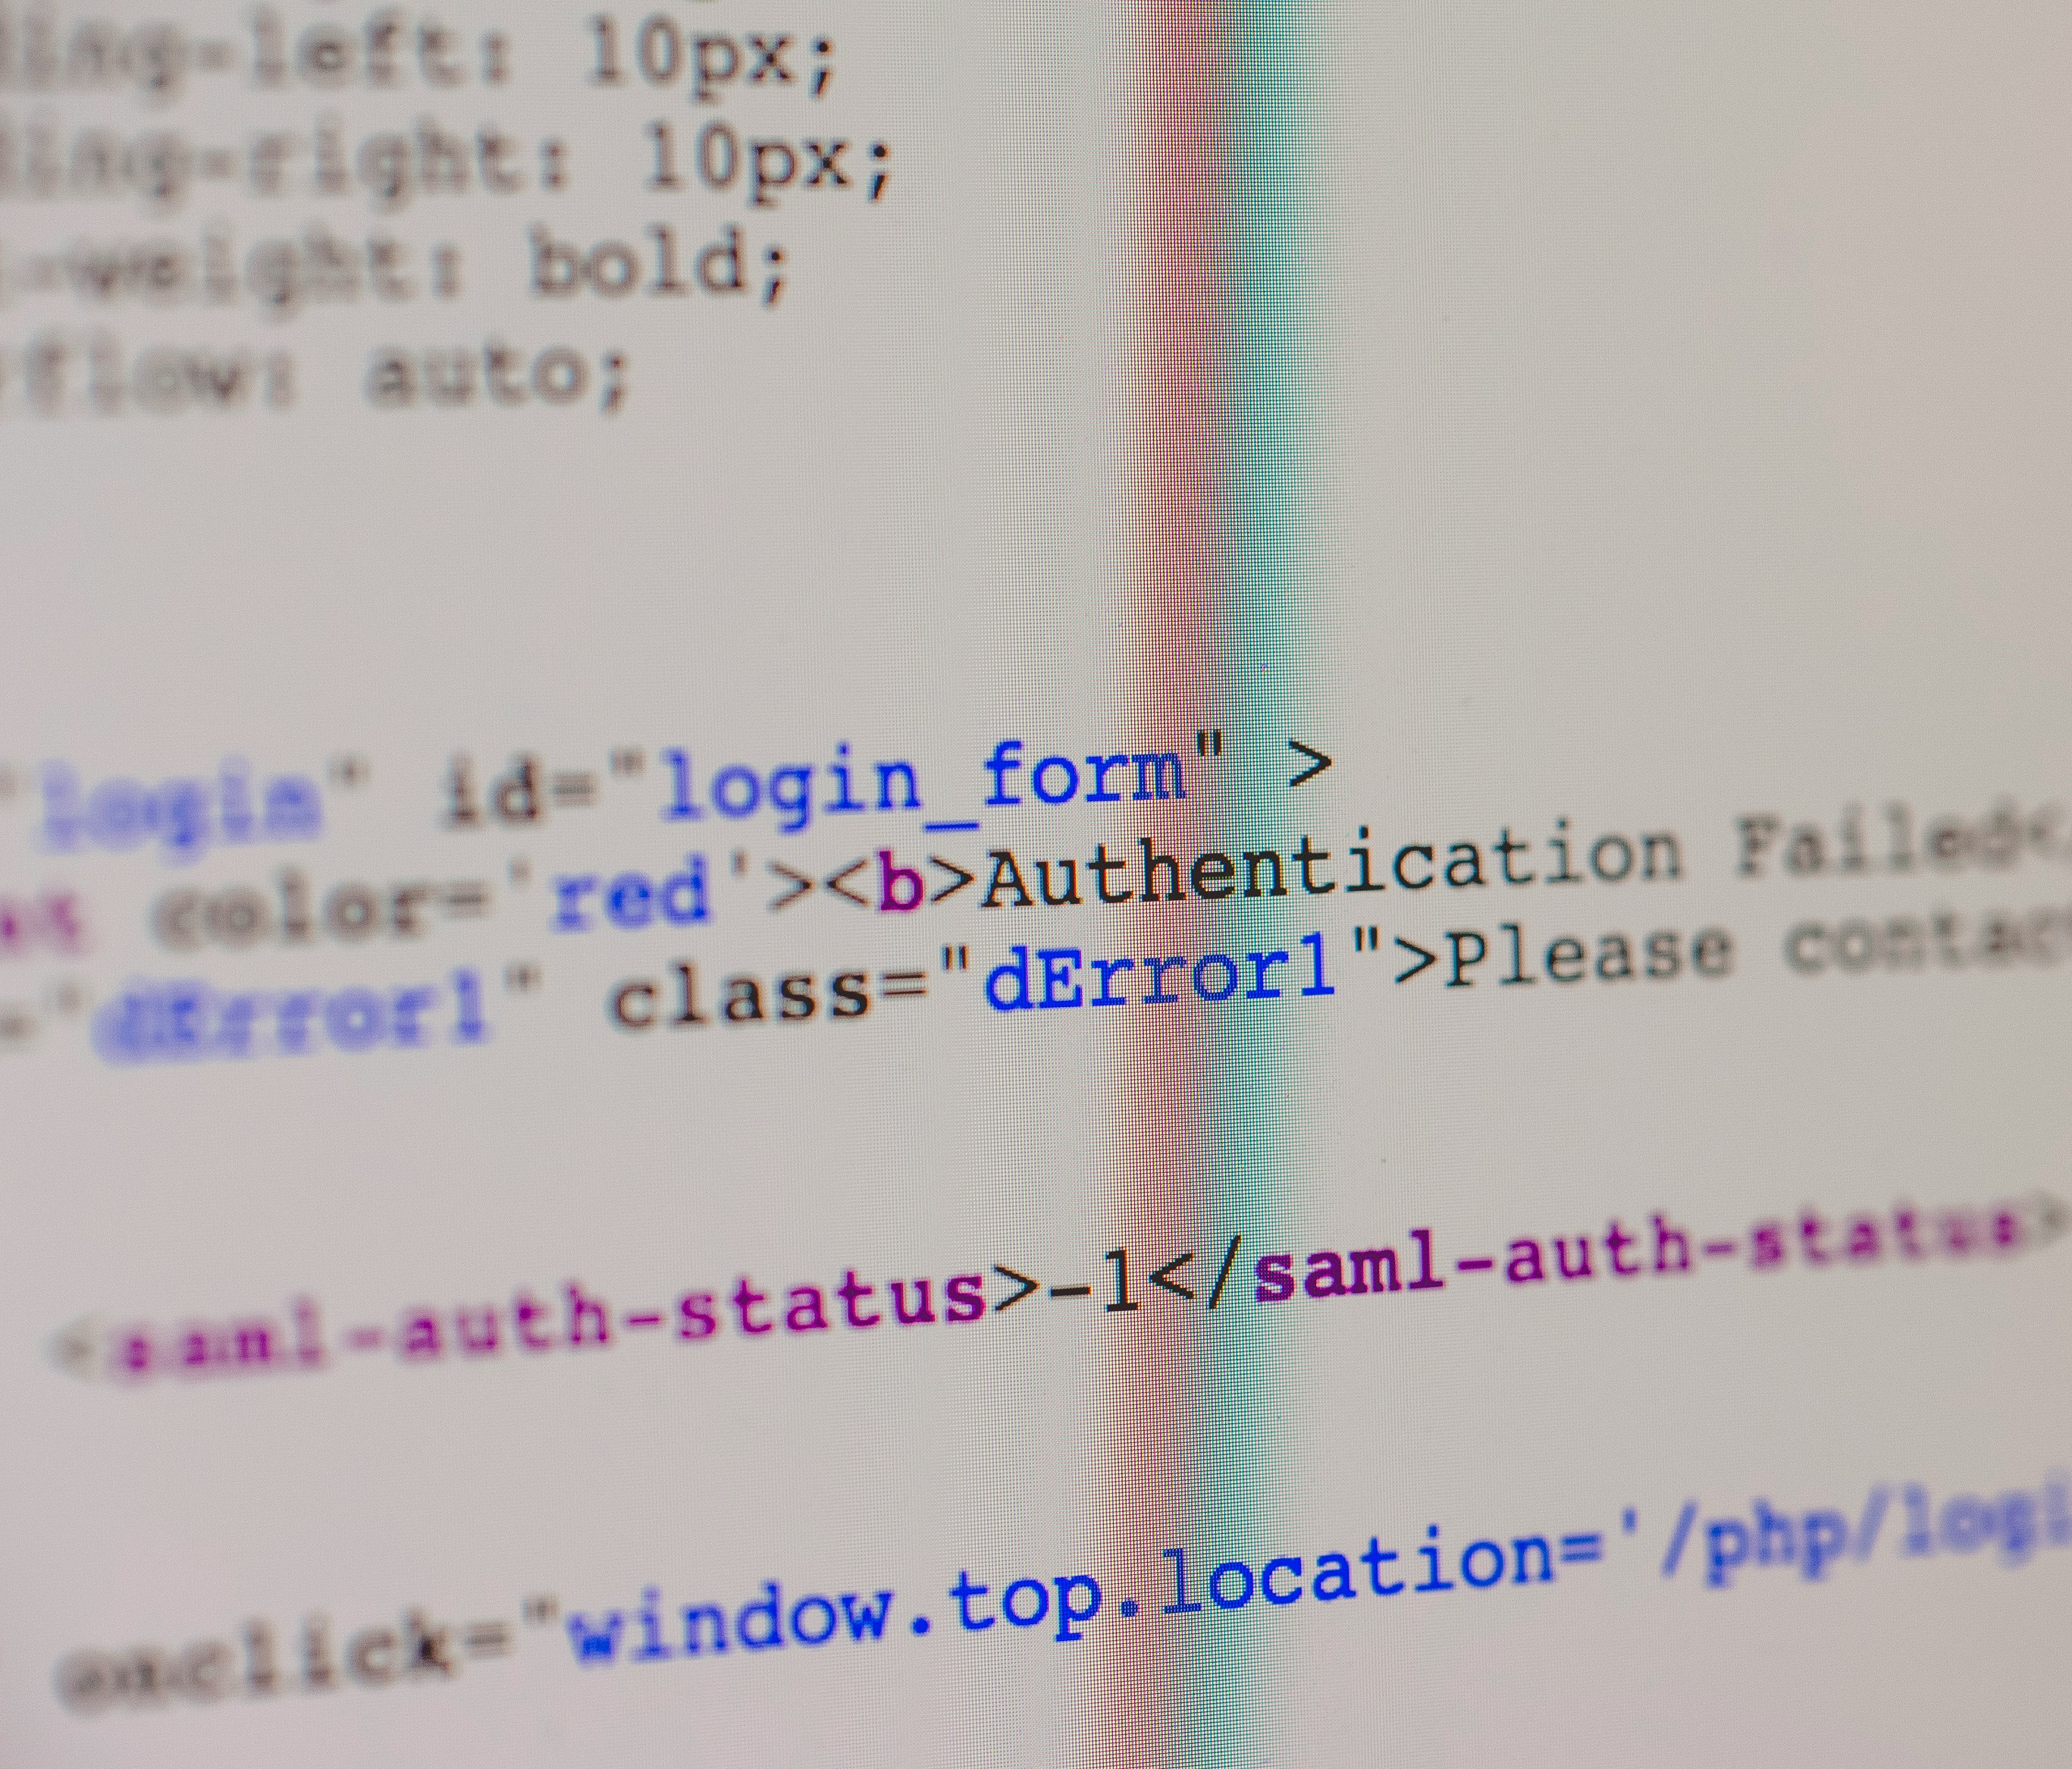
Bugs and problems
Android 4.3 - 4.4 (API 18-19)
Critical Issues:
Inconsistent GATT Callbacks: The onCharacteristicChanged() callback frequently fails to trigger, requiring connection resets
Memory Leaks: The Bluetooth stack leaks memory with repeated connection/disconnection cycles, eventually requiring a device reboot
Connection Limits: Practical limit of 4-7 simultaneous connections despite the theoretical higher limit
Solution: Implement aggressive connection recycling and monitor memory usage closely
Android 5.0 - 5.1 (API 21-22)
Major Issues:
GATT 133 Error: The infamous GATT error 133 occurs frequently during connection attempts, with no clear cause in documentation
Service Discovery Failures: discoverServices() fails intermittently, requiring retry logic with delays of 600ms+
Notification Loss: First notification after enabling CCCD is often dropped
Workaround: Implement exponential backoff retry logic and add 600-1000ms delay after connection before service discovery

Slide 9
Bugs and problems
Android 6.0 (API 23)
Location Permission Bug: BLE scanning requires ACCESS_FINE_LOCATION permission and location services must be enabled, even though BLE doesn't inherently require GPS. This confuses users and requires clear UI explanation.
Android 7.0 - 8.1 (API 24-27)
Issues:
Background Scanning Limitations: Aggressive battery optimization kills background BLE scanning without user notification
Connection Priority Problems: Setting connection priority via requestConnectionPriority() often fails silently
MTU Negotiation Failures: requestMtu() succeeds but the actual MTU remains at default 23 bytes on certain devices

Slide 10
Bugs and problems
Android 12+ (API 31+)
Breaking Changes:
New Permission Model: BLUETOOTH_SCAN, BLUETOOTH_CONNECT, BLUETOOTH_ADVERTISE replace coarse location requirements
Scan Filter Restrictions: More aggressive filtering when neverForLocation flag is used
Companion Device Manager: Recommended for device pairing, but adds complexity
Persistent Bug: On Pixel devices running Android 12-13, rapid connect/disconnect cycles can crash the Bluetooth stack, requiring airplane mode toggle.

Slide 11
Bugs and problems
Android 6.0 (API 23)
Location Permission Bug: BLE scanning requires ACCESS_FINE_LOCATION permission and location services must be enabled, even though BLE doesn't inherently require GPS. This confuses users and requires clear UI explanation.
Android 7.0 - 8.1 (API 24-27)
Issues:
Background Scanning Limitations: Aggressive battery optimization kills background BLE scanning without user notification
Connection Priority Problems: Setting connection priority via requestConnectionPriority() often fails silently
MTU Negotiation Failures: requestMtu() succeeds but the actual MTU remains at default 23 bytes on certain devices

Slide 12
iOS BLE Issues
iOS 9 - 10
Major Issues:
State Preservation Bug: Background state preservation fails if app is force-quit by user, with no way to detect this state
Delayed Callbacks: didDiscoverPeripheral callbacks delayed by 1-5 seconds in background mode
Memory Issues: Rapid scanning causes memory pressure warnings and app termination

Slide 13
iOS BLE Issues
iOS 14 - 15
Widget Background Scanning: BLE scanning in widgets doesn't wake app reliably
M1 Simulator: BLE completely non-functional in M1 Mac Simulators (hardware limitation)
Rapid Reconnection Problem: Attempting reconnection within 1 second of disconnect fails silently; requires 2+ second delay

Slide 14
iOS BLE Issues
iOS 16+
Crash on Invalid UUID: Passing malformed UUID strings causes immediate crash instead of throwing error
Background Notification Limit: Background apps limited to ~20 notifications per minute per peripheral
Privacy Report: System privacy report logs all BLE activity, concerning some users
Critical Bug (iOS 16.0-16.3): Extended advertising data parsing fails when payload exceeds 31 bytes, causing crash. Fixed in 16.4.

Slide 15
Flutter BLE Issues
flutter_blue_plus Common Problems:
Android Service Discovery: Fails on Android 12+ with certain devices; requires enabling autoConnect parameter
iOS Null Safety: Older versions crash when receiving null characteristic values
Hot Reload Issues: BLE state persists incorrectly after hot reload, requiring full app restart
MTU Request Timing: Must wait for connection to fully establish before requesting MTU; timing is device-dependent

Slide 16
Flutter BLE Issues
flutter_reactive_ble Issues:
Android Background: Background operation unreliable without proper foreground service implementation
Stream Memory Leaks: Subscription streams not properly cleaned up, causing memory growth
iOS Simulator: Completely non-functional on simulator, requires physical device

Slide 17
Questions?

